Slide 1
ATMP ARCHER TASK MANAGEMENT PORTAL
Made By:
JINALI N.SHAH(080460116051)
AKASH P.SHAH(080460116049)
Guided By:
Asha Patel

Slide 2
Introduction
Archer Solutions is software service company offering offshore Software and web development.
Outsource software & web development, open source software development, rich web 2.0 development, web design, web development, ecommerce solutions.
PHP/ASP.Net/Ajax programming and iphone app development from India.

Slide 3
Industrial define project
The primary problem that we found at Archer Solutions is that they are having their head office in Ahmedabad and have no of developers working for the company remotely for different domains and technologies.

Slide 4
Secondary problem : Sometimes the information does not reach to the employees on time or the information is received by the wrong employee which may create delay in the task completion.

Slide 5
Detailed description of the problem
Archer Solutions Pvt. Ltd. deals with software designing; website designing etc. it has clients in various parts of the world.
The remote office of Archer Solutions is located at Ahmedabad and it has expanded its business in various countries like U.K., China, Noida etc. In order to handle the clients the company needs to appoint various employees in different countries.

Slide 6
AHMEDABAD
(Remote center)
Communication
Communication
NOIDA
ARCHERY SOLUTIONS PVT. LTD.
CHINA
problem
problem
Communication
problem
UNITED KINGDOM

Slide 7
PROJECT DEFINATION
A.T.M.P. empowers their clients, offering them direct control over their projects and supporting them every step of the way.
A.T.M.P. is a Software Solutions delivers with exceptional professionalism and full return on investment accountability.

Slide 8
PURPOSE
A.T.M.P. is more powerful because task is a fundamental unit of anything we do, so if we do something wrong on task level, it will affect the whole project or business plan.
We gathered all the knowledge about task management starting from creating a task till its completion and present task management technique as practical and useful tips for people who want to work better as the better you manage tasks the more productive you are.

Slide 9
PROJECT SCOPE
Archer task management portal provides employee the best way to communicate with their company project from Archer tech solutions.
Employees can see different projects regarding their interest.
A.T.M.P. gives the details of employee profile.
Employee can comment any anytime on the project and can inform their department’s manager about the completion of the work.

Slide 10
USER TYPES
ADMIN type which will authenticate the employee.
H.R. will manage the work of all three types of user types.
PROJECT MANAGER which does the many operations on the employee tasks like add project, delete project, update project, timeliness for project etc.
EMPLOYEE which does the different tasks on their project on their given applications.

Slide 11
MODULES OF A.T.M.P.
Employee module
Login
Registration
Verification link
Contact module
To contact the company
Message inbox

Slide 12
MODULES OF A.T.M.P.
Feedback module
Discuss project
Comment
E-mail
Internal messaging
Contact directly to company

Slide 13
MODULES OF A.T.M.P.
Admin module
To upload company details
To remove unnecessary projects
To edit changes in projects
To manage employees
To manage project details
To manage all employees information
To provide updated new projects to the employees

Slide 14
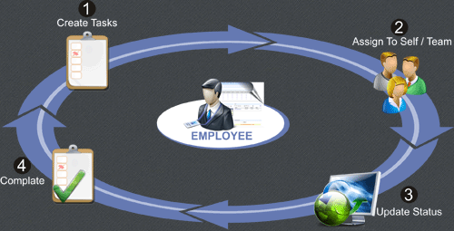
IMPLEMENTATION ENVIRONMENT

Slide 15
FRONT END :
PHP , HTML ,XHTML, JAVA SCRIPT.
BACK END :
SQL.

Slide 16
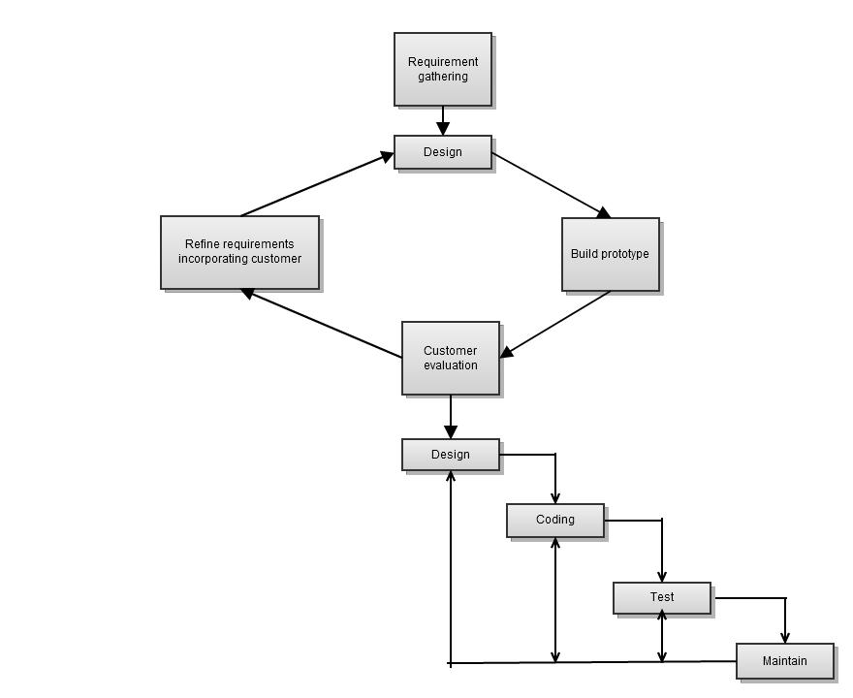
PROTOTYPE MODEL

Slide 17
DATABASE

Slide 18
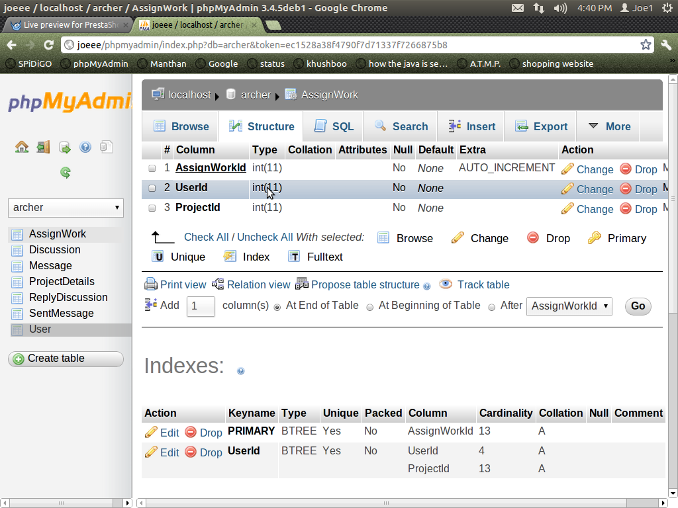
PROJECT DETAILS

Slide 19
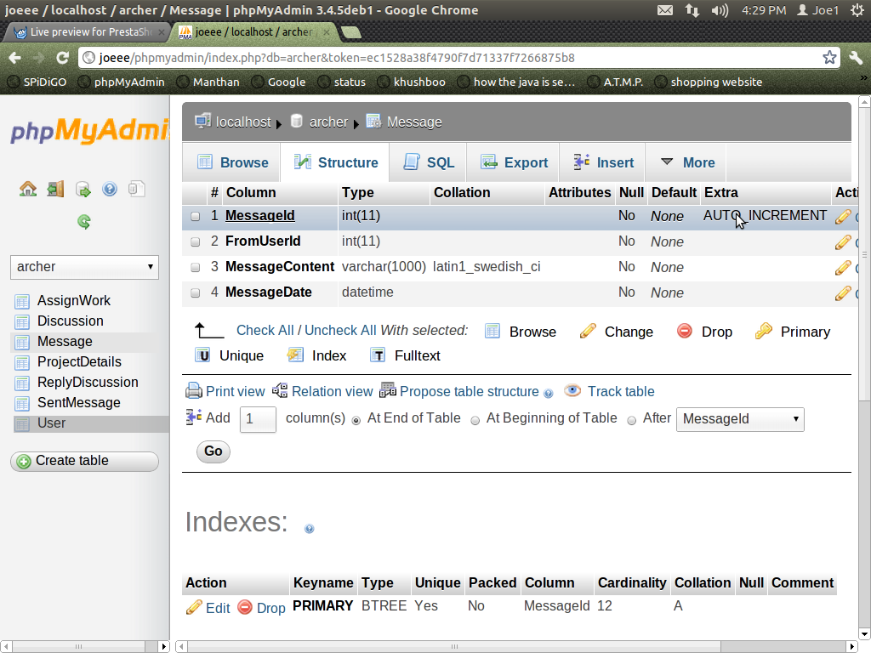
MESSAGE TABLE

Slide 20
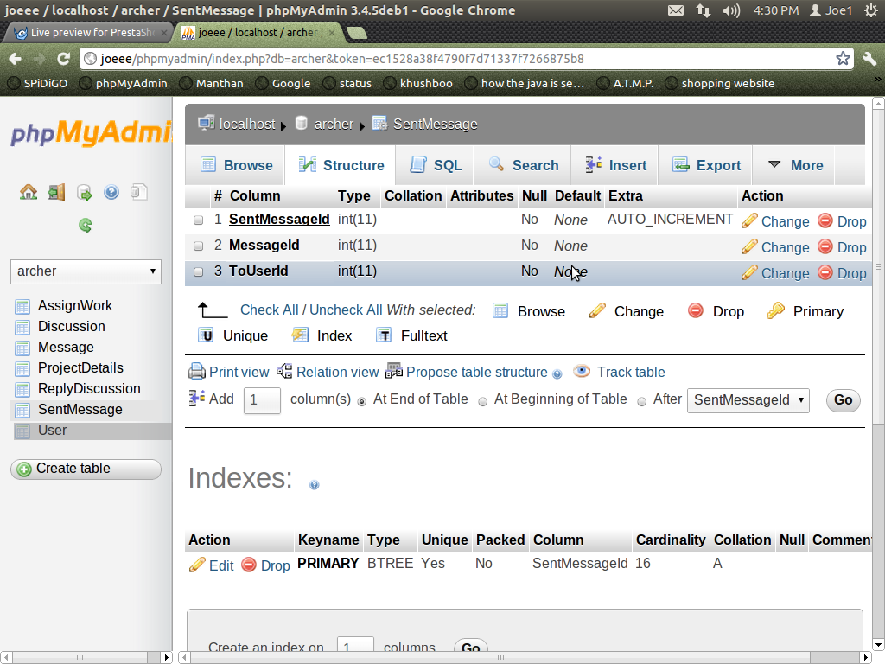
SENT MESSAGE TABLE

Slide 21
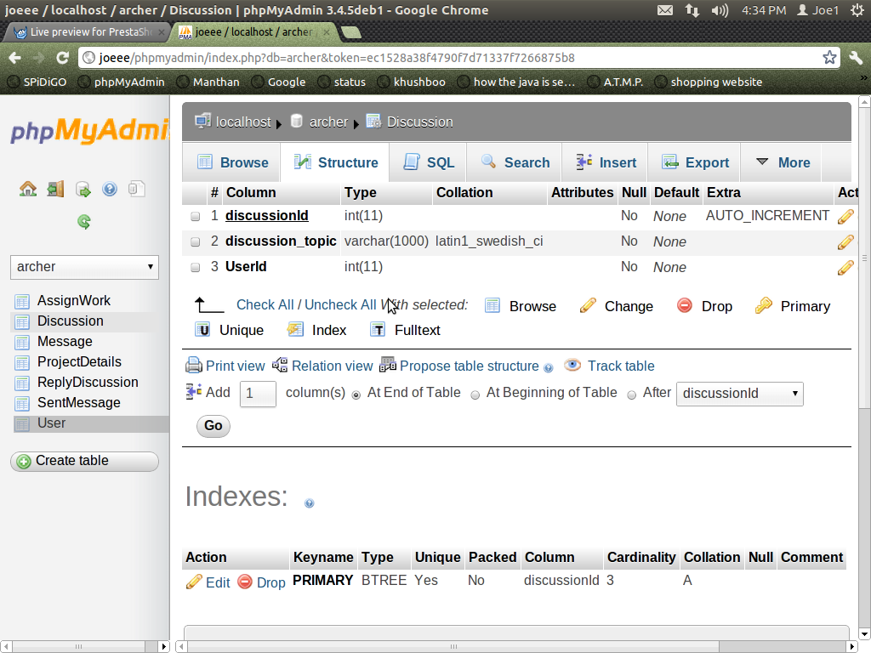
DISCUSSION TABLE

Slide 22
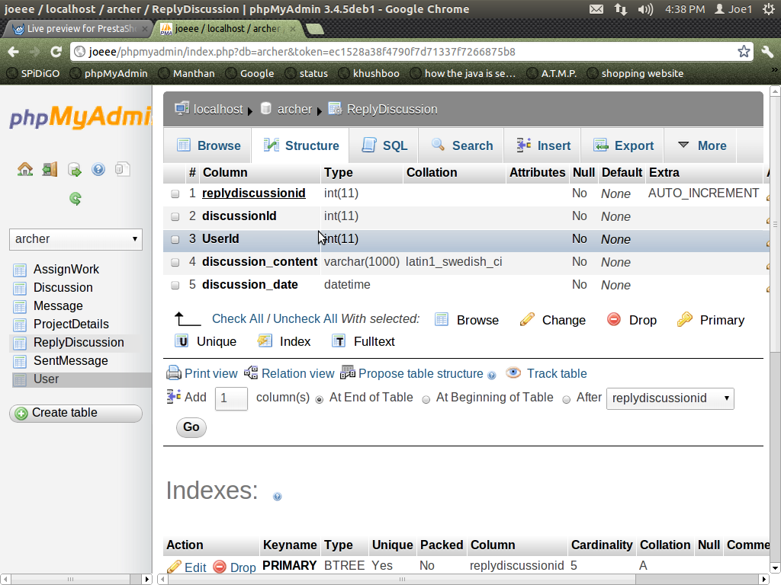
REPLY DISCUSSION TABLE

Slide 23
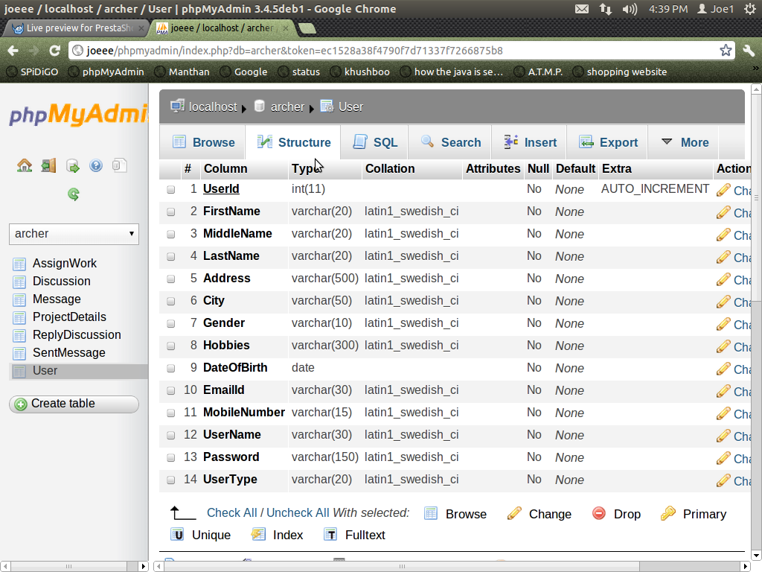
USER TABLE

Slide 24
ASSIGN WORK TABLE

Slide 25
DESIGN & IMPLEMENTATION

Slide 26
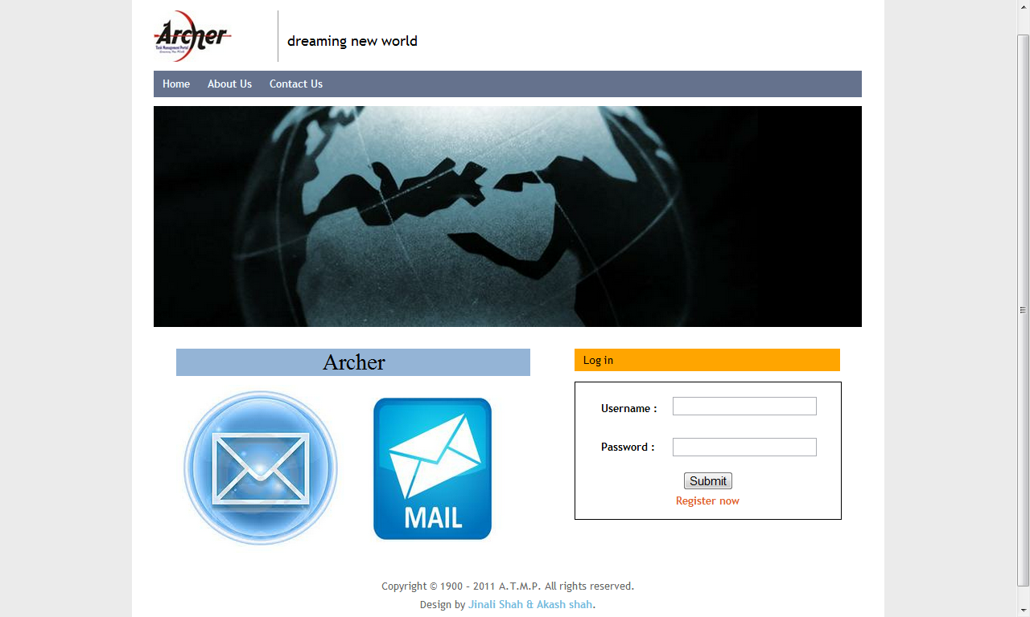

Slide 27
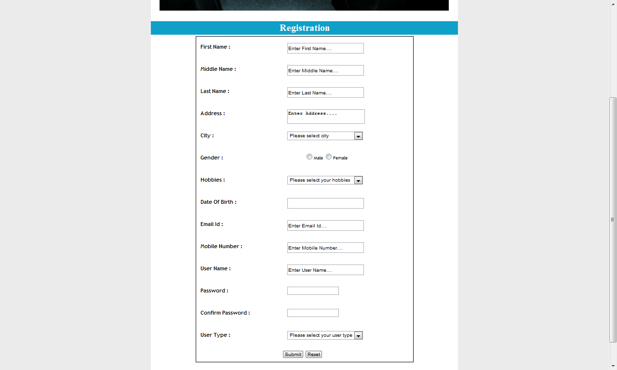

Slide 28
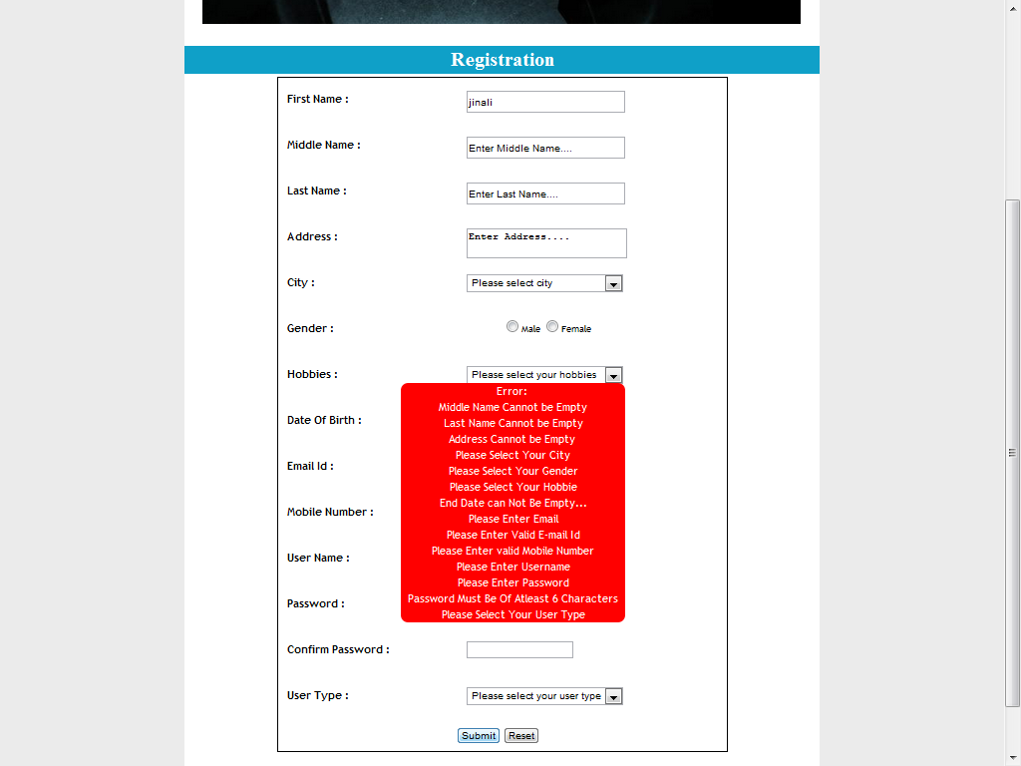

Slide 29
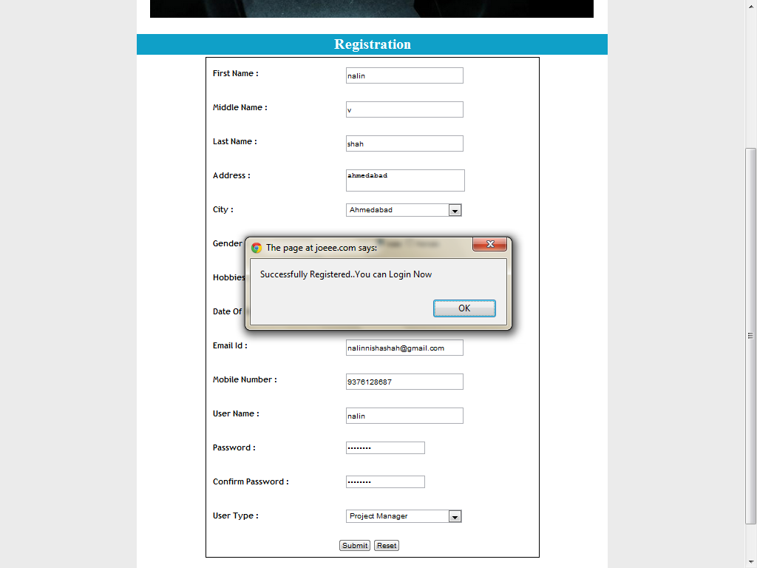

Slide 30
ADMIN MODULE

Slide 31


Slide 32
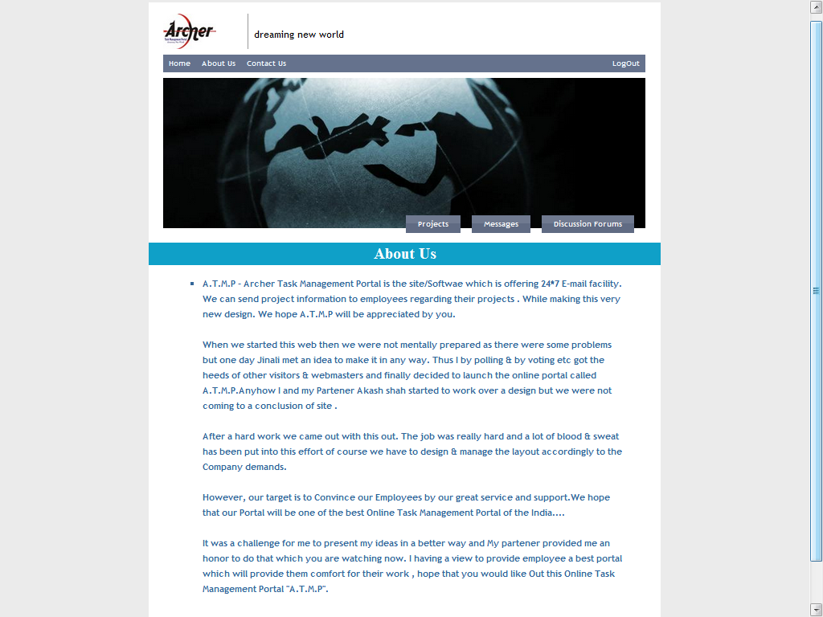

Slide 33
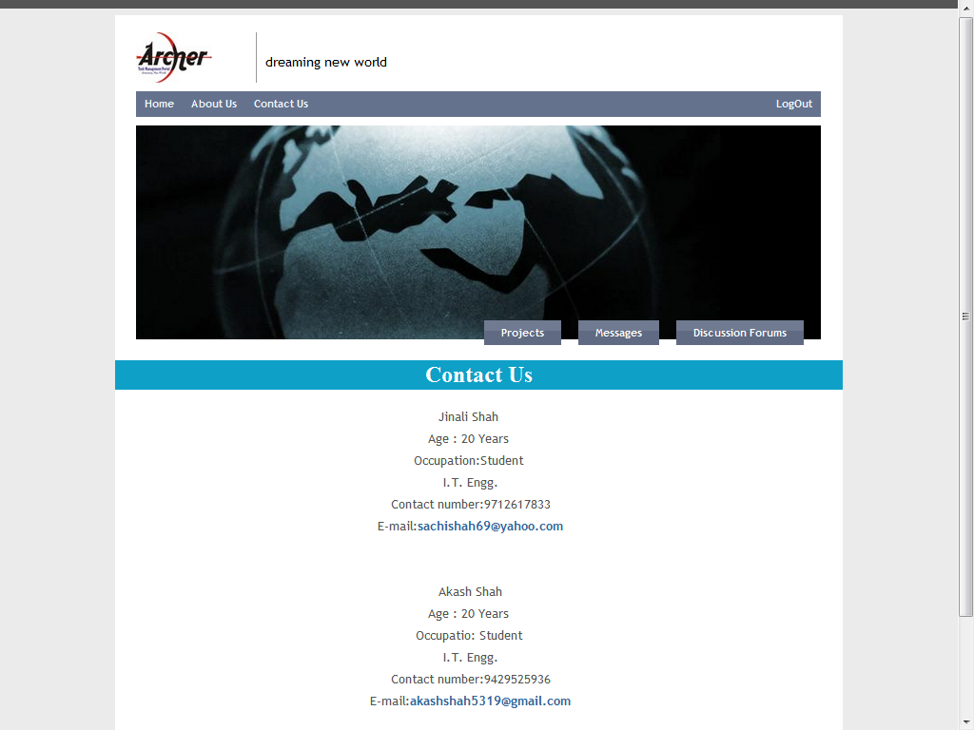

Slide 34
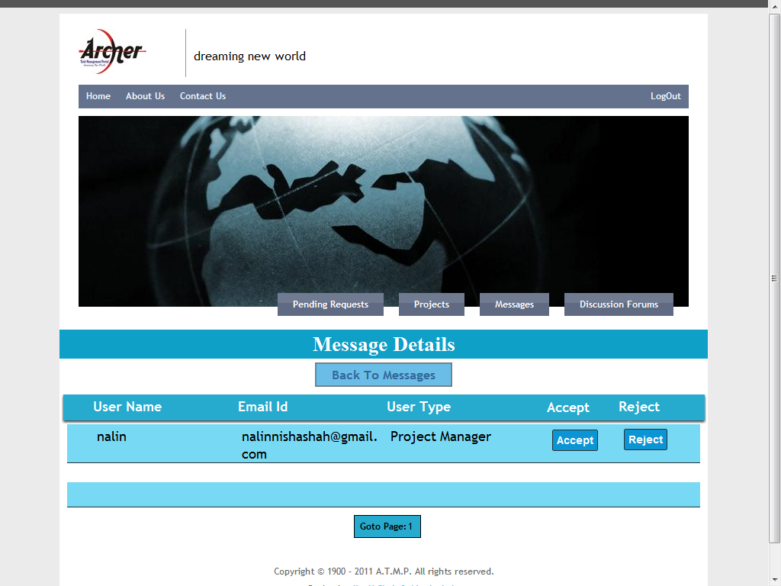

Slide 35
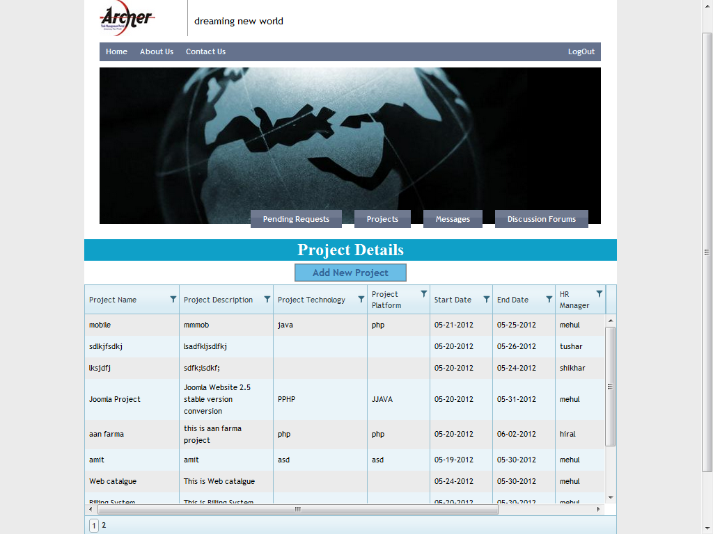

Slide 36
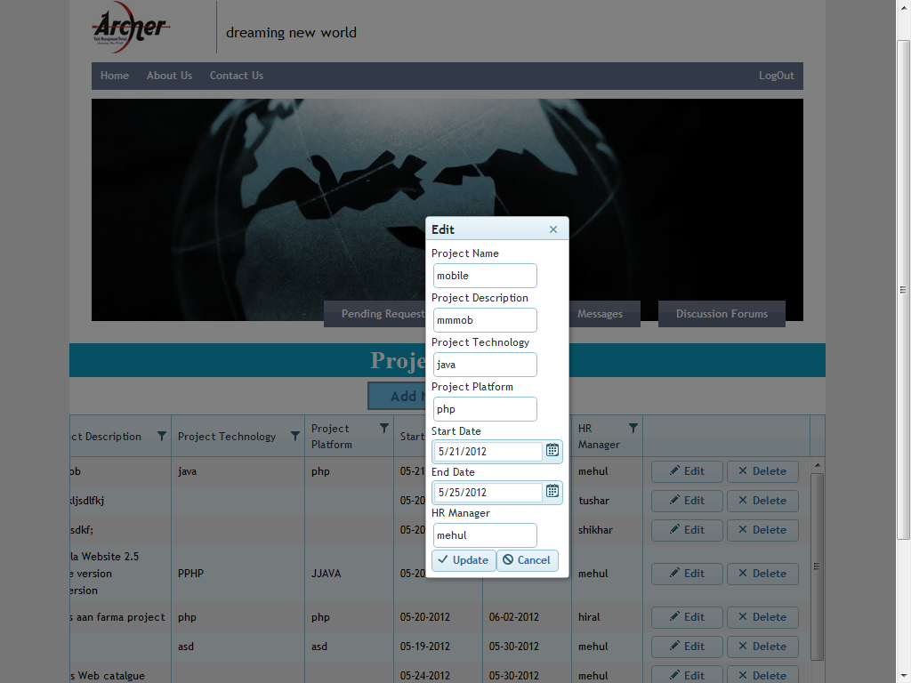

Slide 37


Slide 38
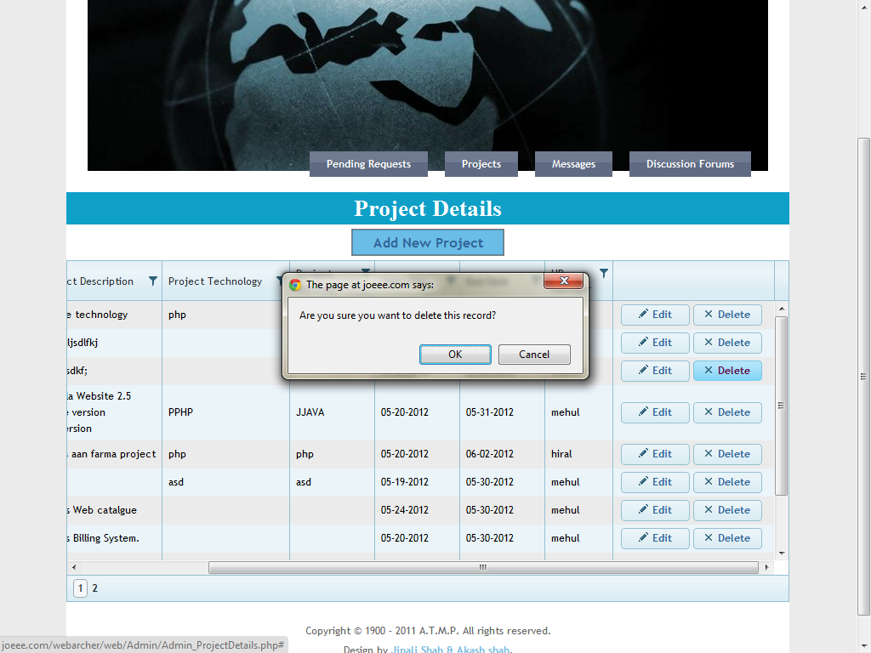

Slide 39
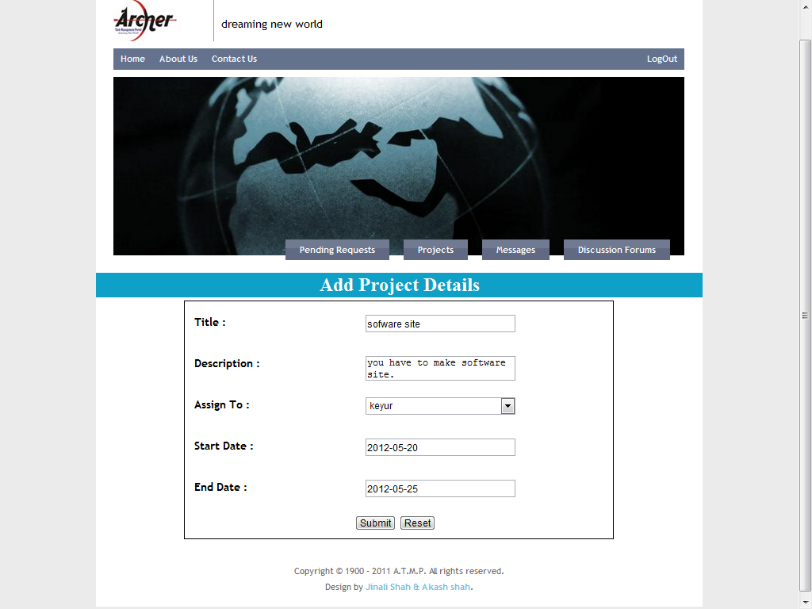

Slide 40
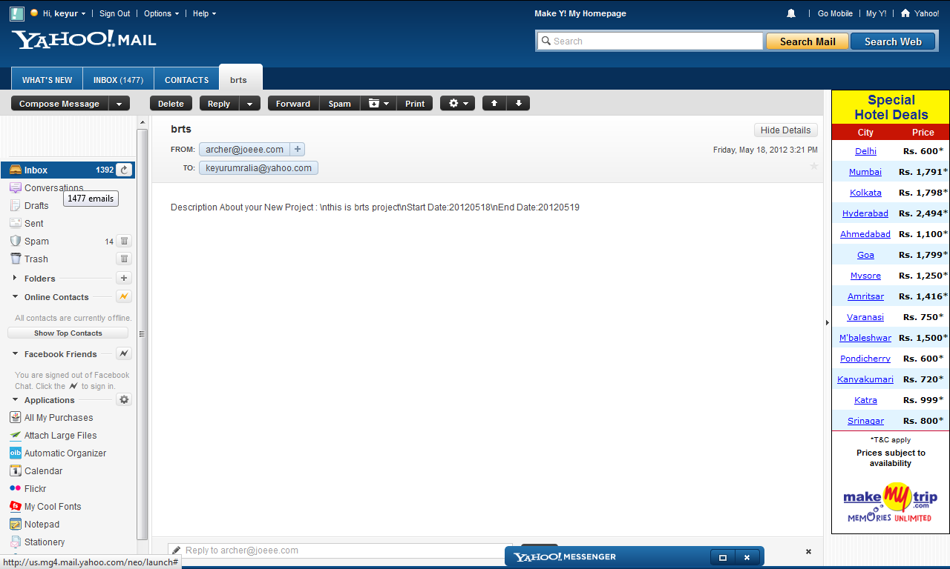

Slide 41
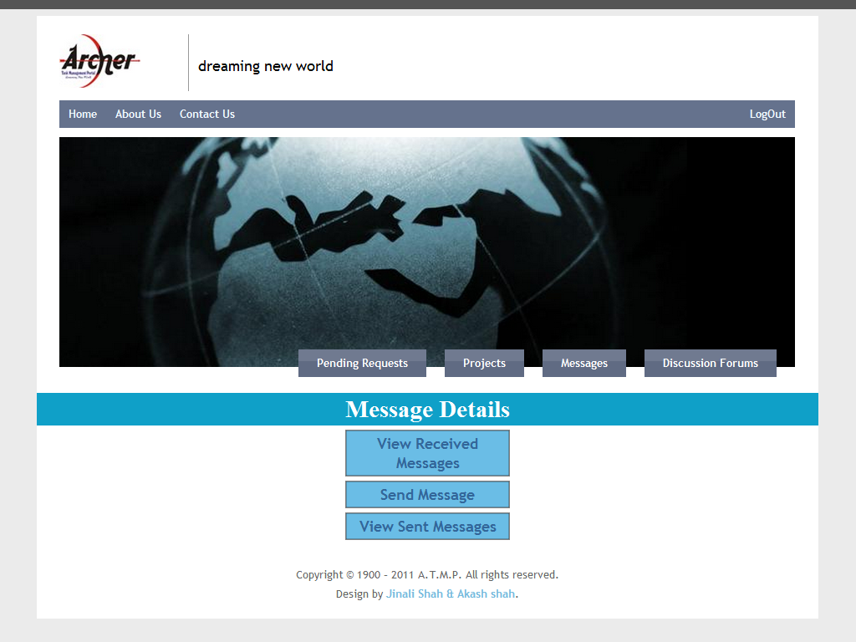

Slide 42
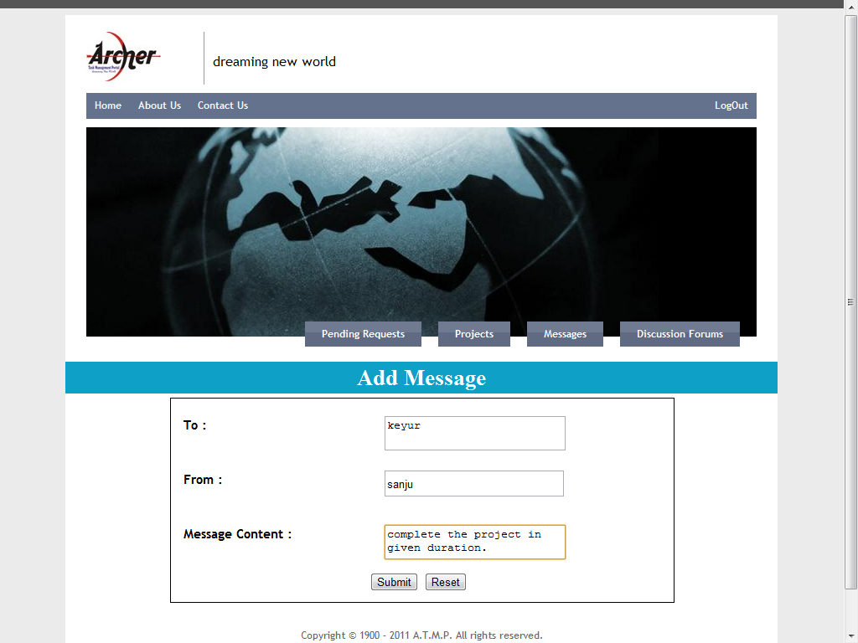

Slide 43
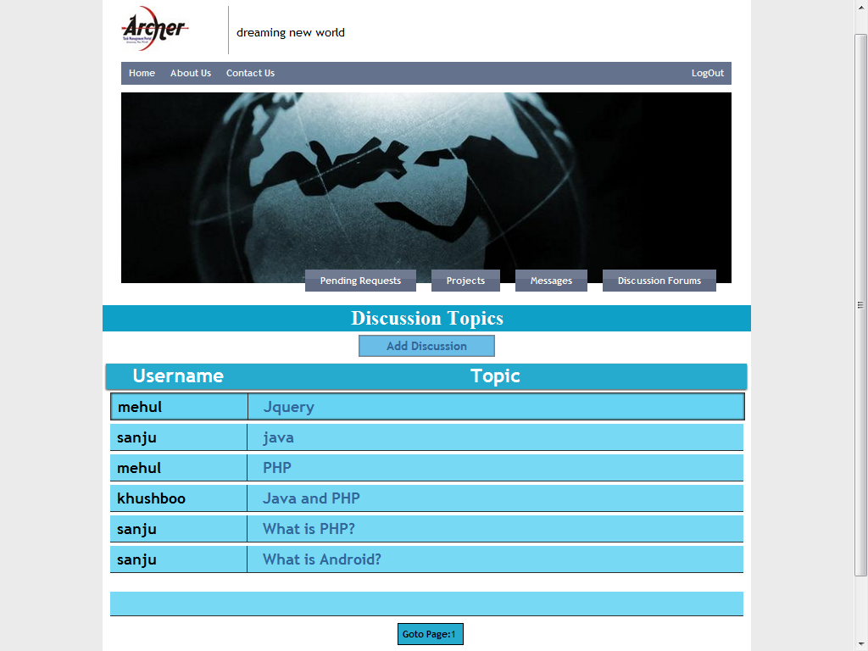

Slide 44
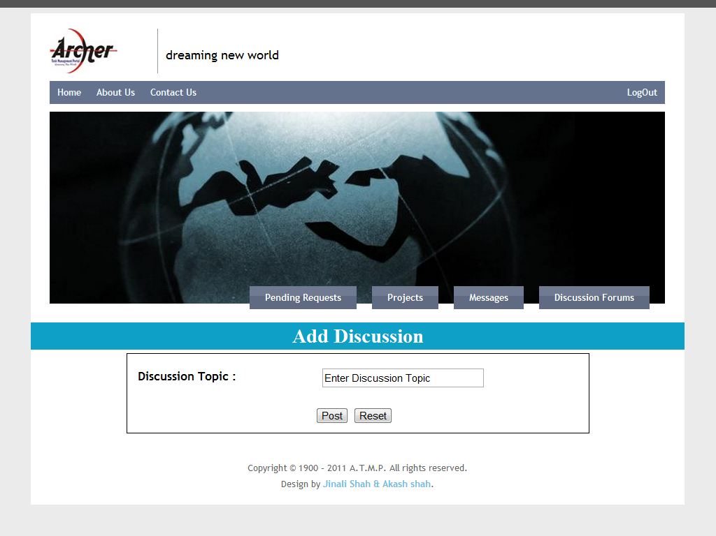

Slide 45
H.R. MODULE

Slide 46
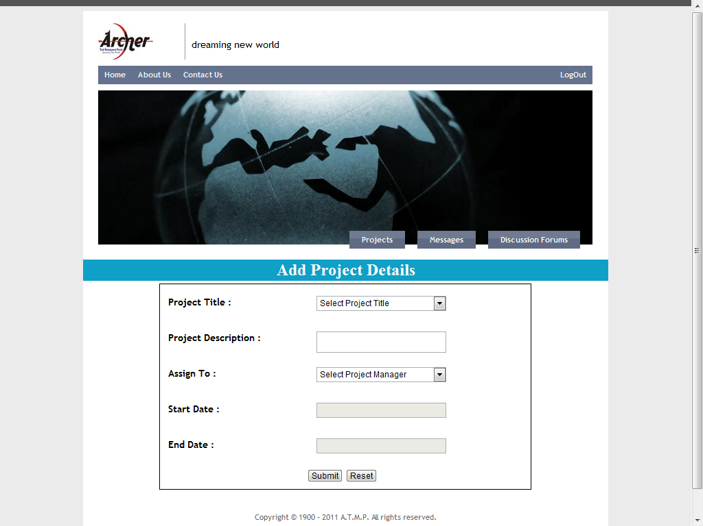

Slide 47
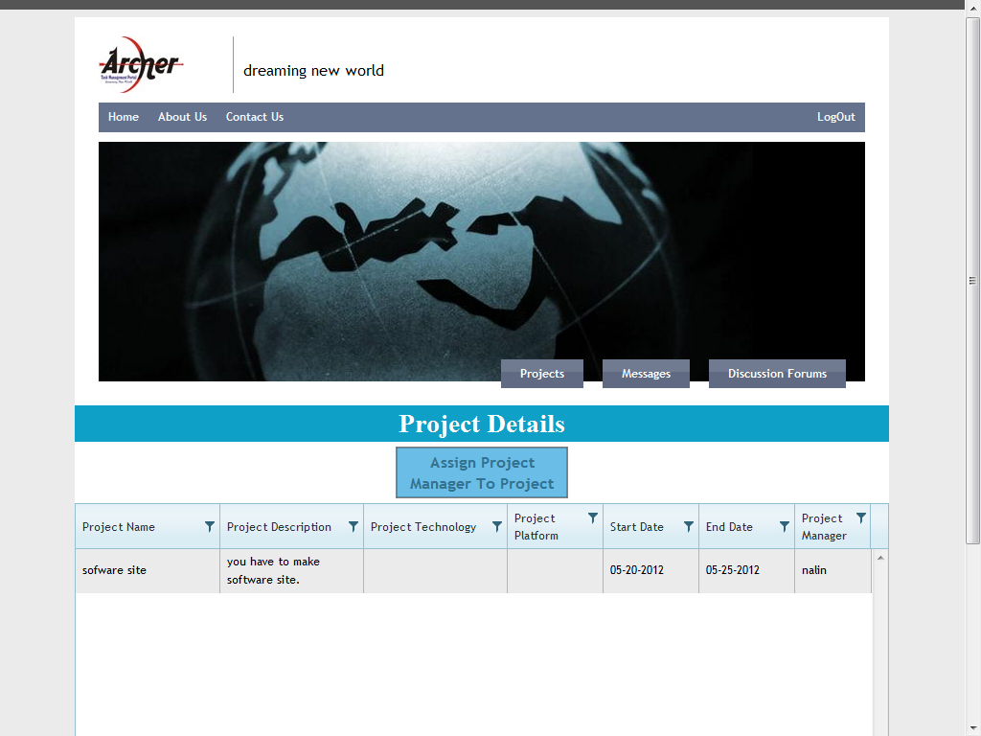

Slide 48
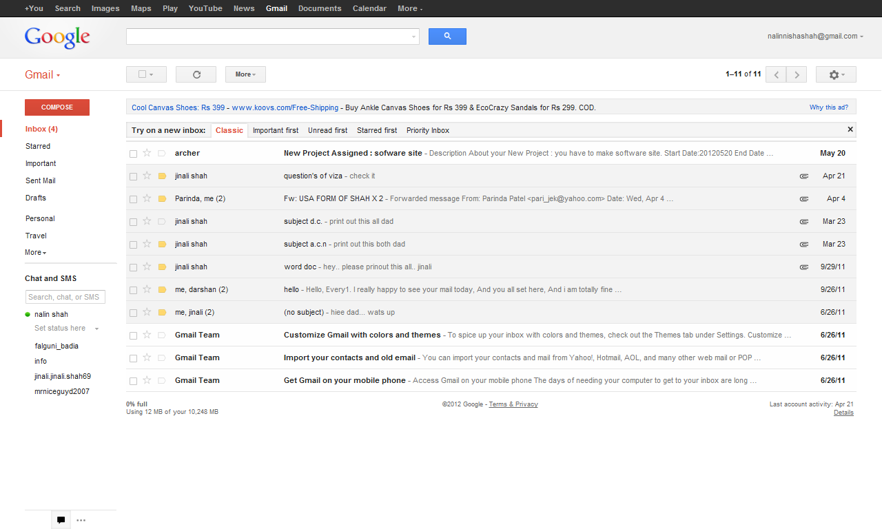

Slide 49
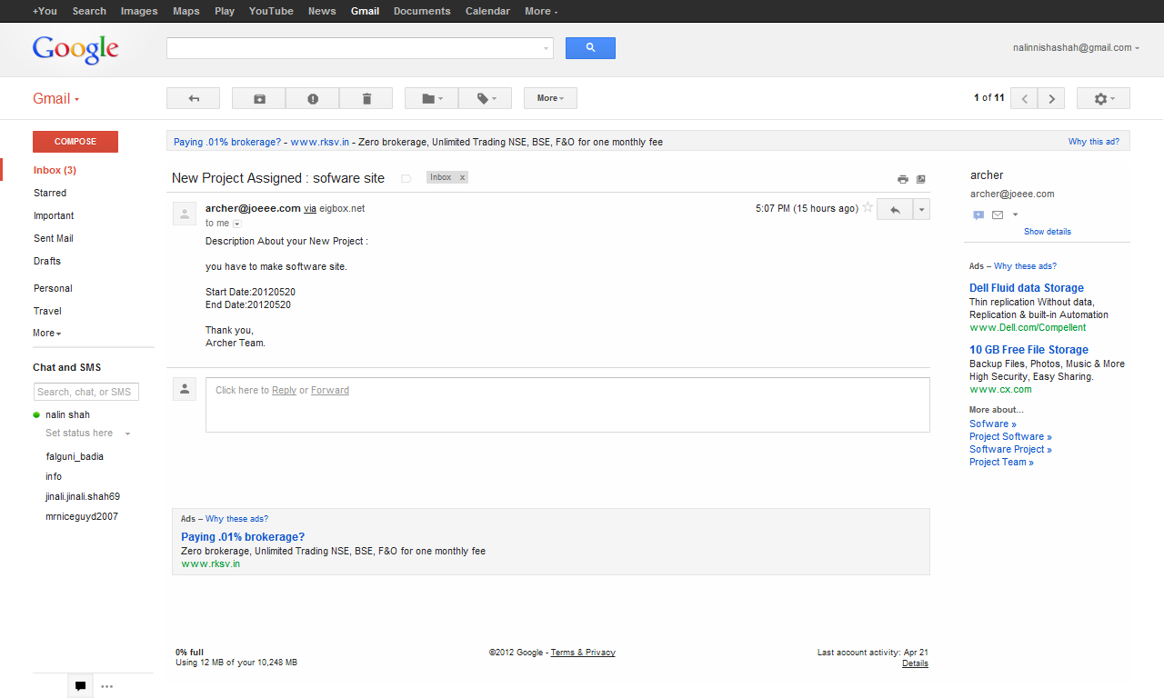

Slide 50


Slide 51
PROJECT MANAGER’S
MODULE

Slide 52
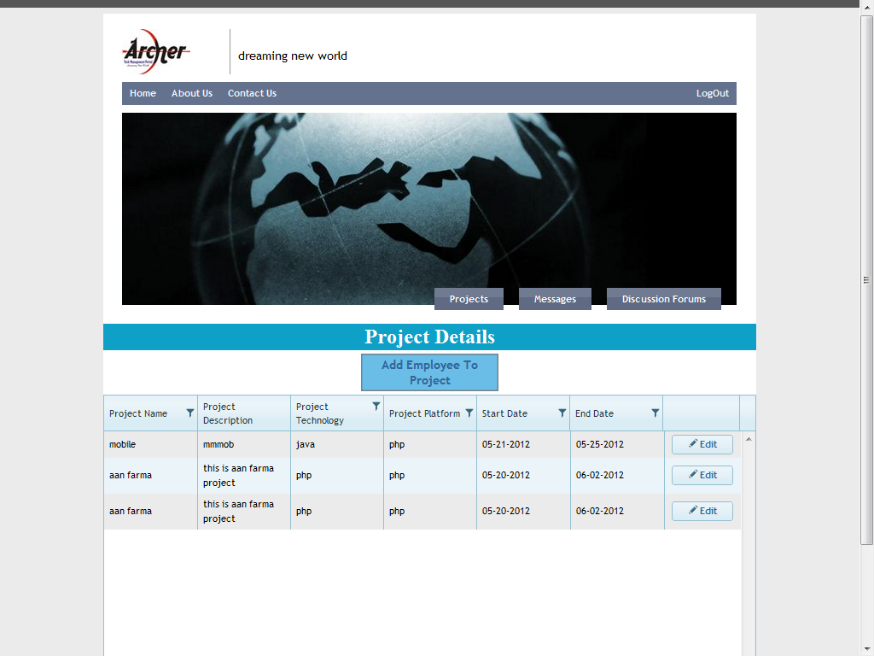

Slide 53
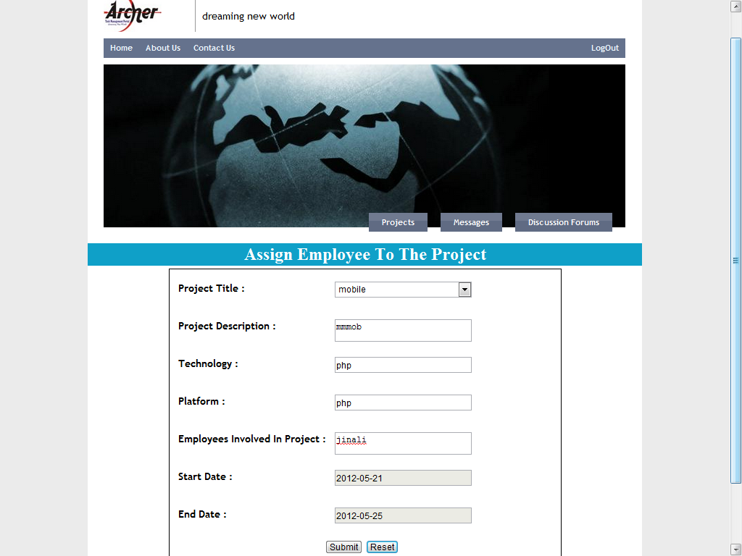

Slide 54
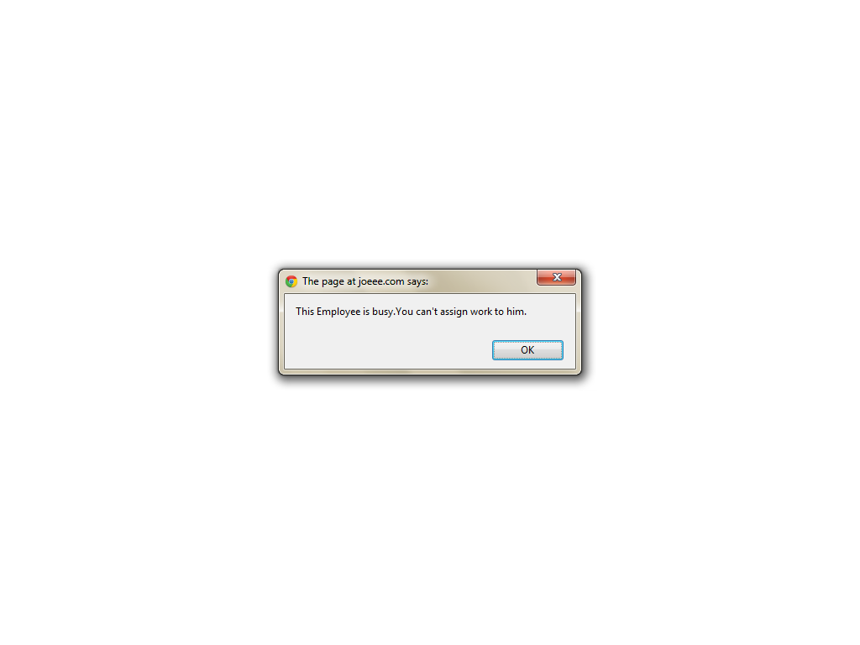

Slide 55
EMPLOYEE MODULE

Slide 56
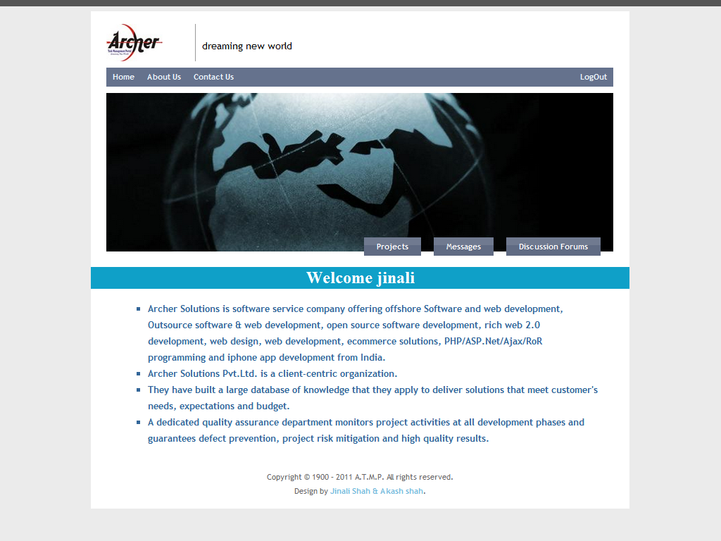

Slide 57
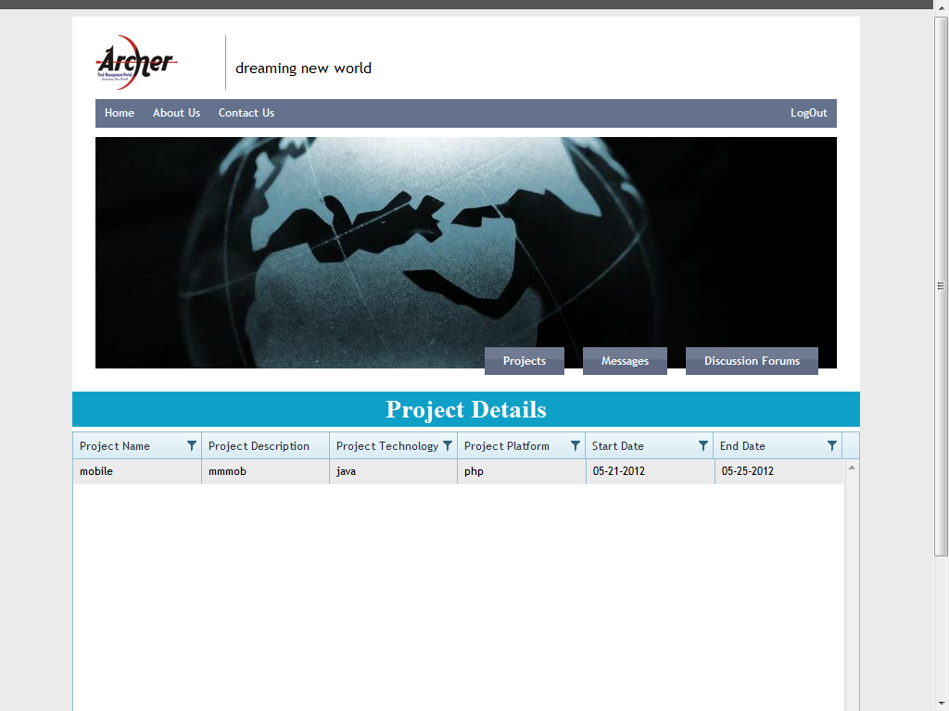

Slide 58
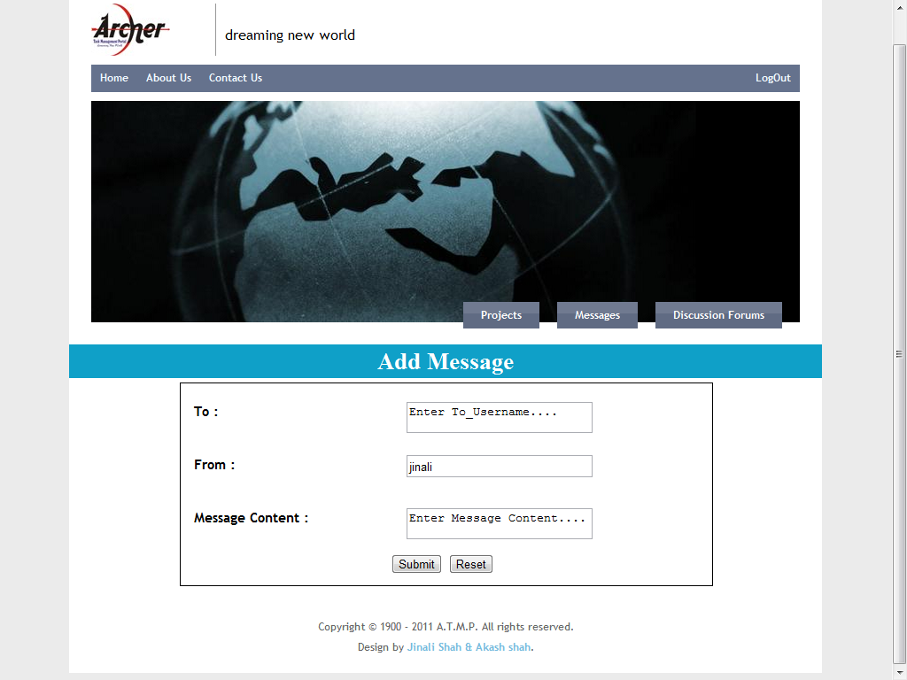

Slide 59
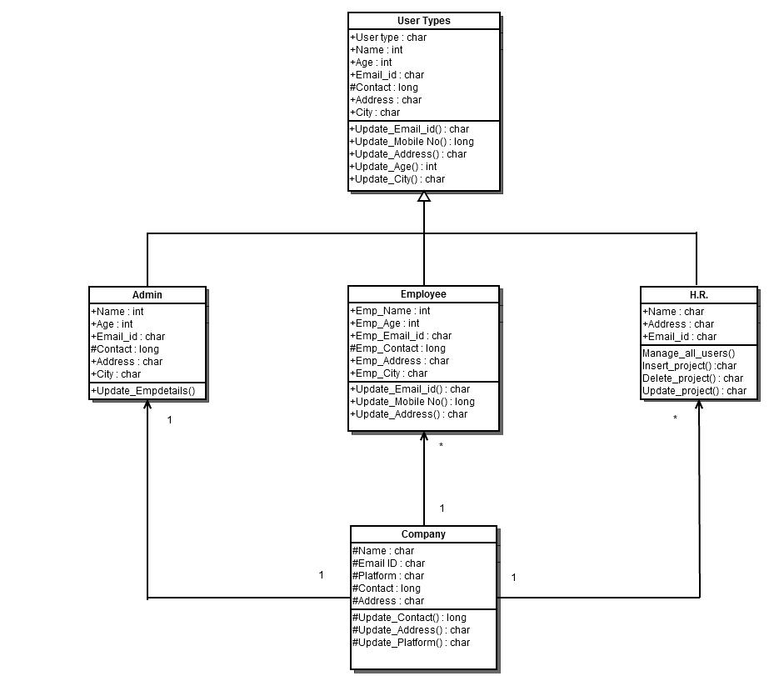
CLASS DIAGRAM

Slide 60
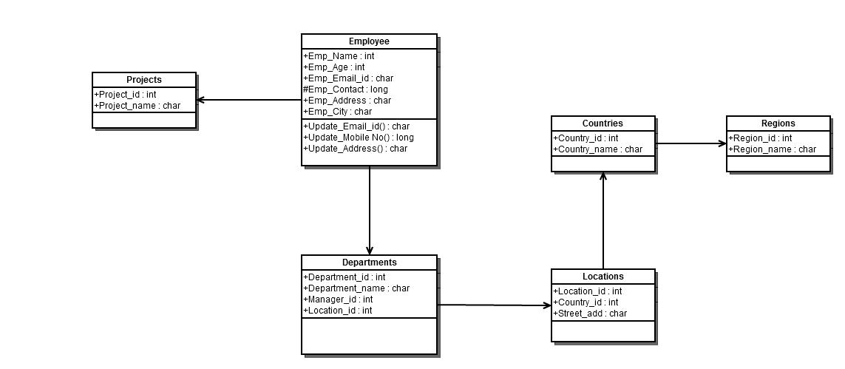
CLASS DIAGRAM

Slide 61
CLASS DIAGRAM

Slide 62
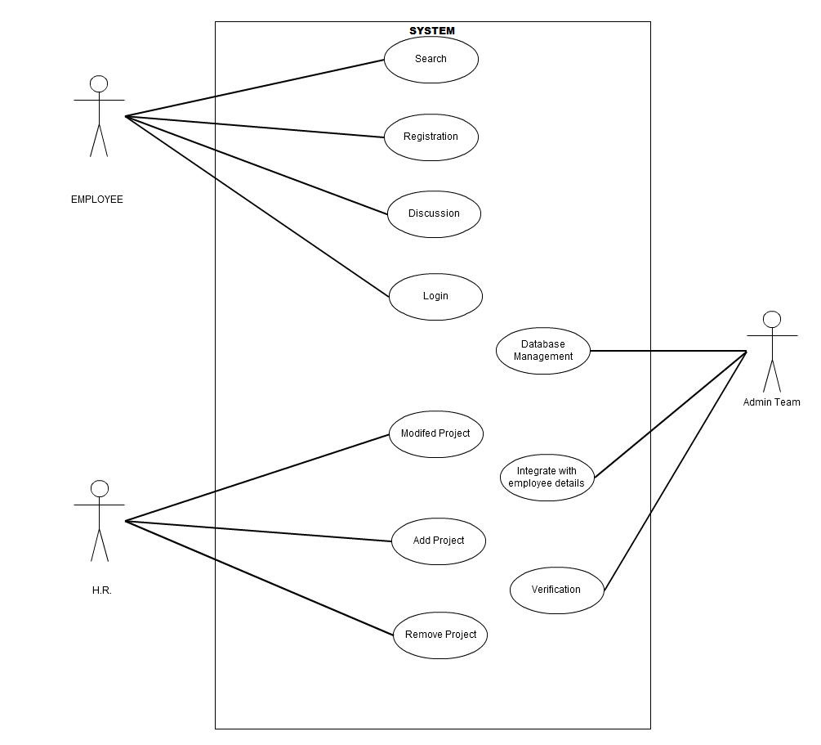
USE-CASE DIAGRAM

Slide 63
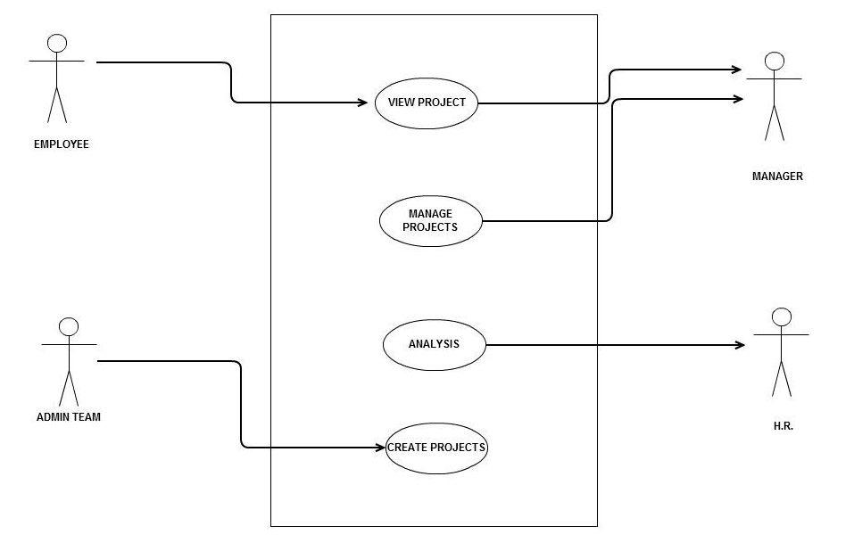
USE-CASE DIAGRAM

Slide 64
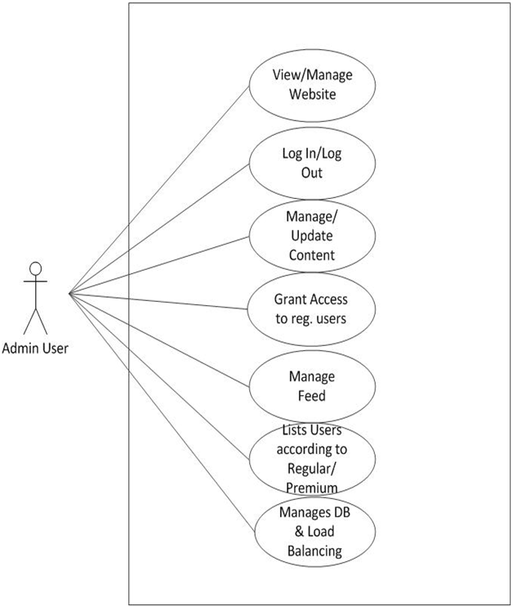
Use Case Diagram for Admin User

Slide 65
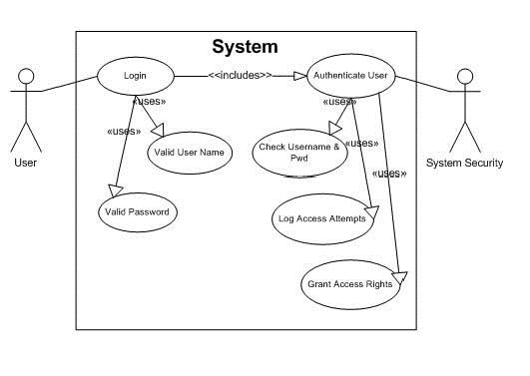
Use Case Diagram for Login Processes

Slide 66
Use Case Diagram for Message

Slide 67
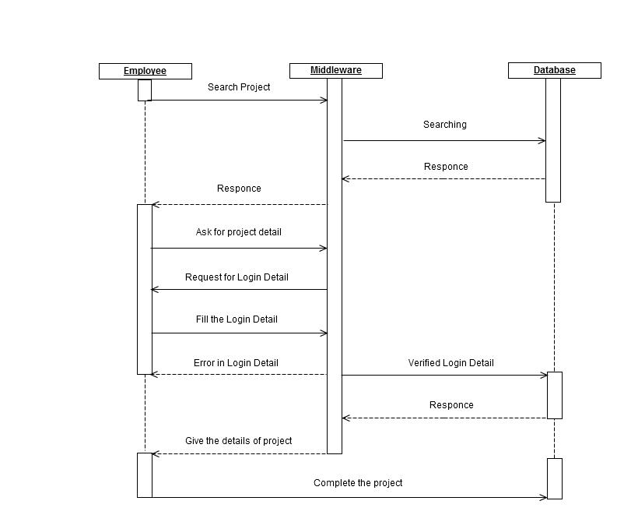
SEQUENCE DIAGRAM

Slide 68
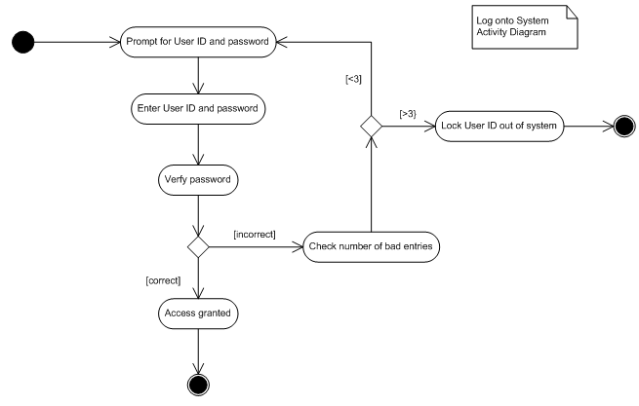
ACTIVITY DIAGRAM

Slide 69
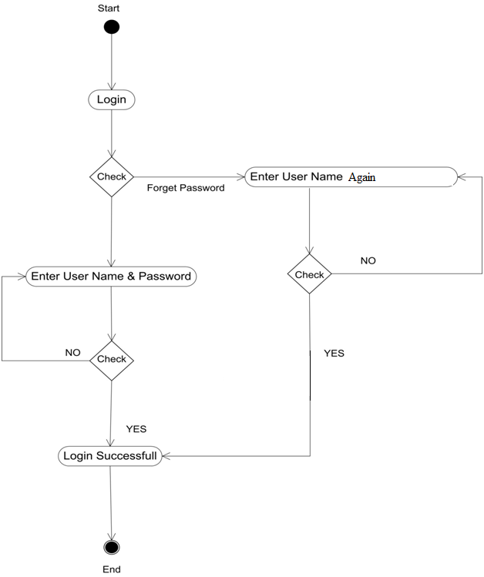
Activity Diagram for Login process

Slide 70
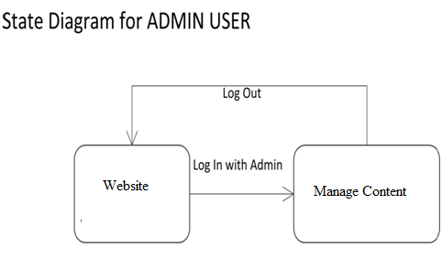
State Diagram for Admin

Slide 71
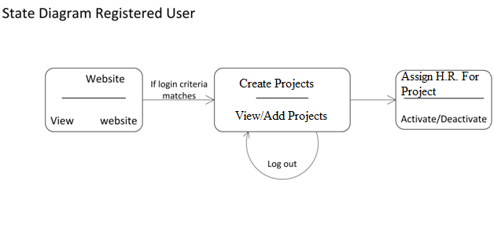
State Diagram for Admin Work

Slide 72
ADVANTAGES
The owner faces the problem on communicating with his employees. The work becomes very tedious, he needs to mail to all the details to the individual employees separately.
So, for their convenience we are making this task management portal by which all the employees can get their task information on time.

Slide 73
FUTURE ENHANCEMENT
A.T.M.P. will provide the best upcoming features to the company Archer tech solutions.
It will enhance the chatting application, an automatic message on the employee’s registered mobile number for new projects and tasks for the employee.
We will make a job portal for the new entries for H.R, Project Manager and so on.

Slide 74
THANK YOU

